Slide 1

KARNATAKA LAW SOCIETY’S GOGTE INSTITUTE OF TECHNOLOGY, BELAGAVI, 590008 - INDIA
BLOOD BANK APP
TEAM NAME – INNOVATORS
TEAM MEMBERS
KARTIK KUMAR CHOUDHARY(TL)
RUSHIKESH PADAKI
SHASHANK SHETTENNAVAR
AISHA MOHAMMED F. DARGA
JASMEET KAUR KOHLI
ANKITA MANJAREKAR
MENTORS
Prof. RAHUL KULKARNI
Prof. VEENA LALBEG

Slide 2
PROBLEM DEFINITION – BLOOD BANK APP [DEPRTMENT OF ATOMIC ENERGY]
The mobile app desired can help provide updated inventory of group wise blood availability in blood banks in close proximity especially during disasters.
This app can also have features to contact blood and platelets donors, when required to donate at the nearest blood bank, utilizing geo tracking of these donors, albeit with their consent.
It can incorporate geographic mapping of blood banks in the country, based on their location, to provide better access to blood during eventualities.

Slide 3
CONTENTS
Emergency networks – Disastrous situations
Geo tracking
Mapping of blood banks
Registration
Donor registration
Recipient’s acknowledgement
Search for blood bank
Search for eligible blood donor
Updating inventory

Slide 4
APPROACHES AND SOLUTIONS
Android application for :
Emergency networks – Networks on demand by ad hoc networks
Geo tracking and Mapping of blood banks – Global Positioning System , Google Maps
Registration , Search for blood bank , eligible blood donor , Updating inventory – PHP , MySQL

Slide 5
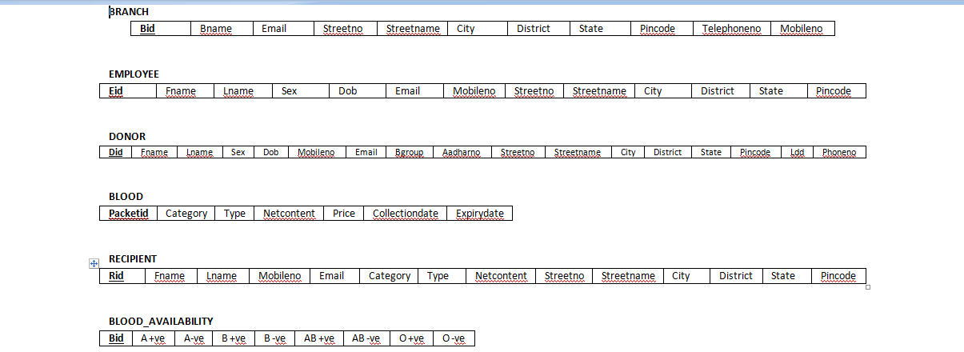
Database Design

Slide 6
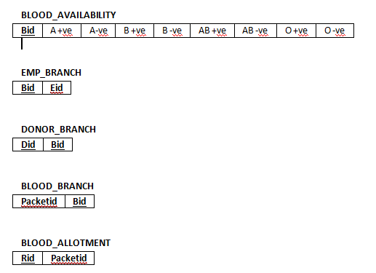
Database Design

Slide 7
RESULTS
Demonstration of working of emergency network.
Tracking the location of eligible donor.
Locating blood banks in closest proximity.
Inventory update.

Slide 8
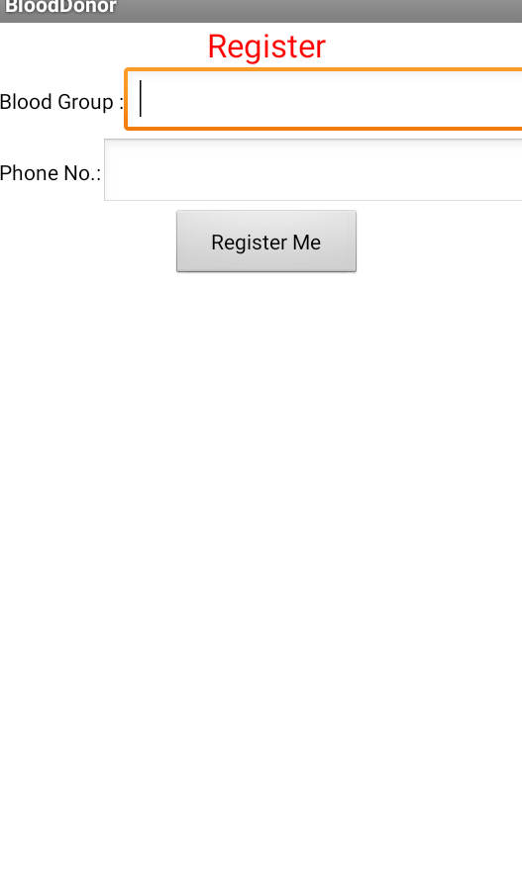
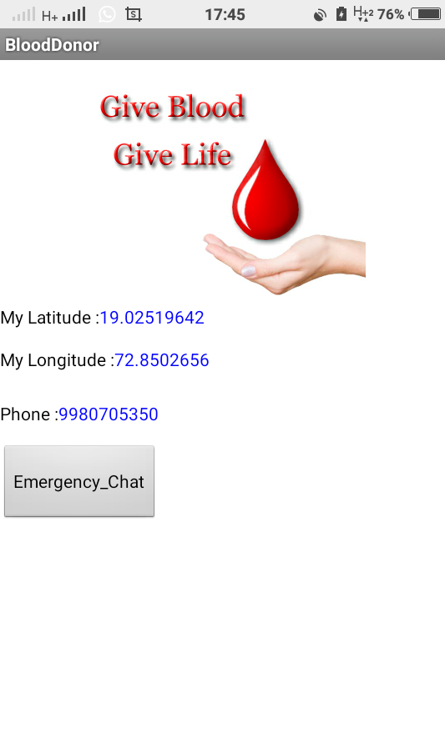
Registration Page

Slide 9
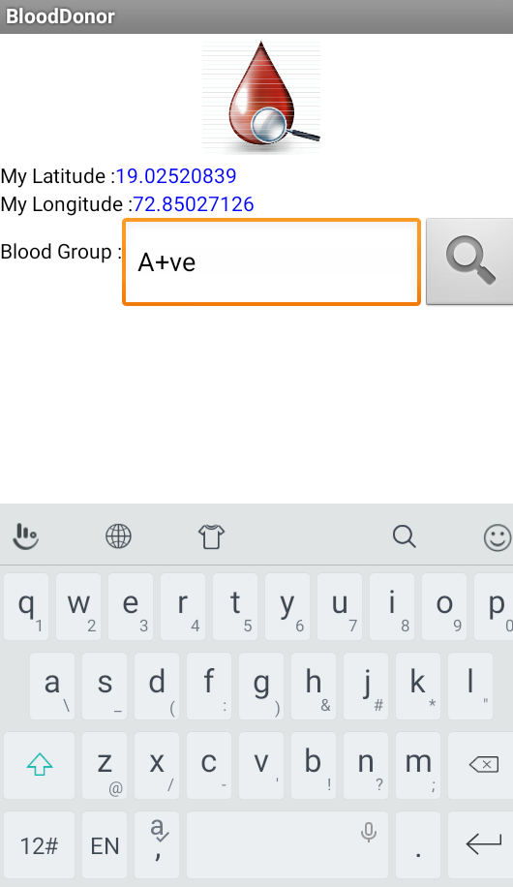
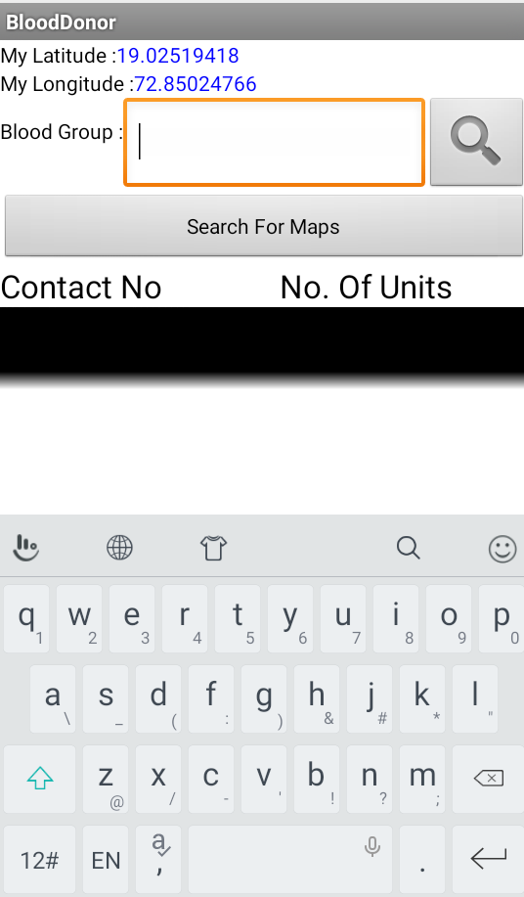
Search by donor and blood bank

Slide 10
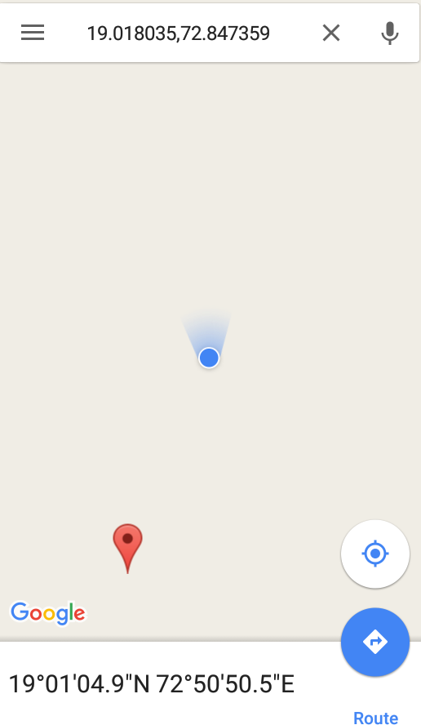
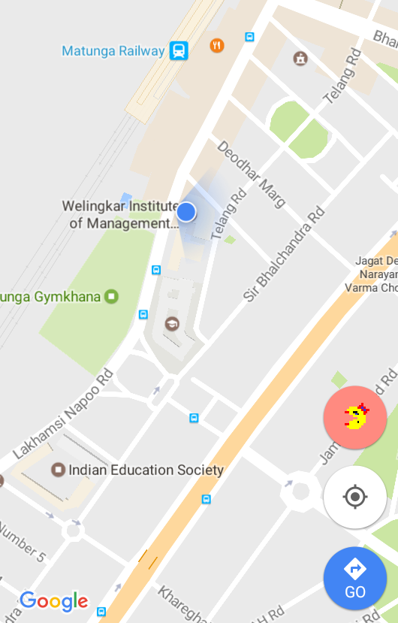
Geo Tracking

Slide 11
PLATFORM
Eclipse
phpmyadmin
Gossip server
MySQL

Slide 13
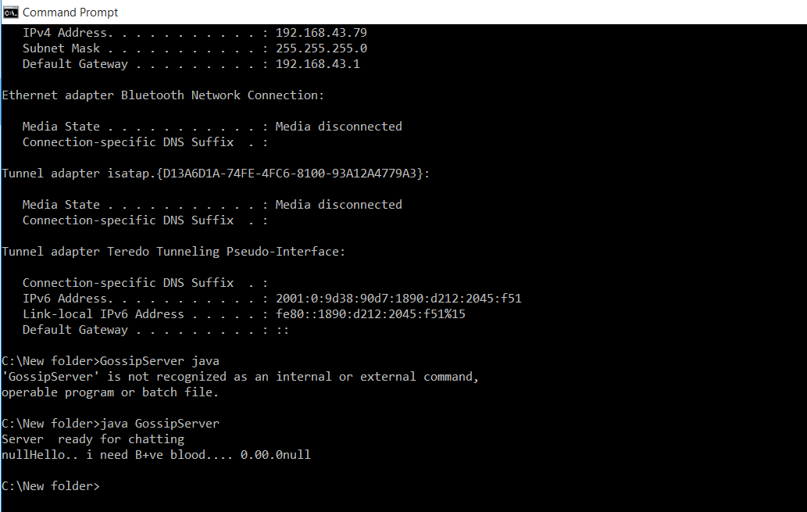
Ad hoc network

Slide 14
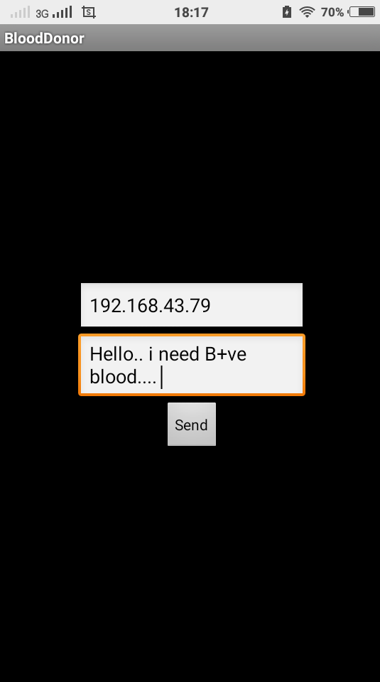
Ad hoc network

Slide 15
Future enhancement
Bar code reader – inventory automation.
Blood bank and Donor Rating.
Linking Aadhar Card number.

